Slide 1
Content
Basic Terms
OOP Basic Features
OOP Principles (SOLID)

Slide 2
Basic Terms
Thinking data first, and gather related actions around the data.
Program = Data Structure + Algorithm
Object = State + Behavior

Slide 3


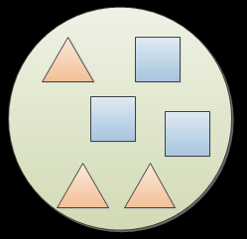
Object
Conceptually similar to real-word objects, consist of state and behavior
State -> Fields, properties, attributes
Behavior -> Methods, functions, events

Slide 4
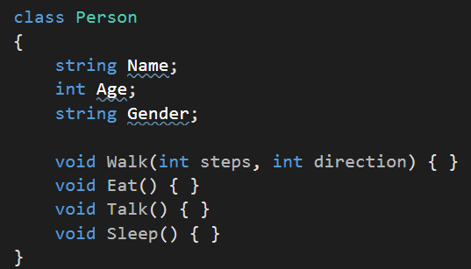
Class
The blueprint of the a kind of objects

Slide 5
OOP Basic Features
Encapsulation
Inheritance
Polymorphism

Slide 6

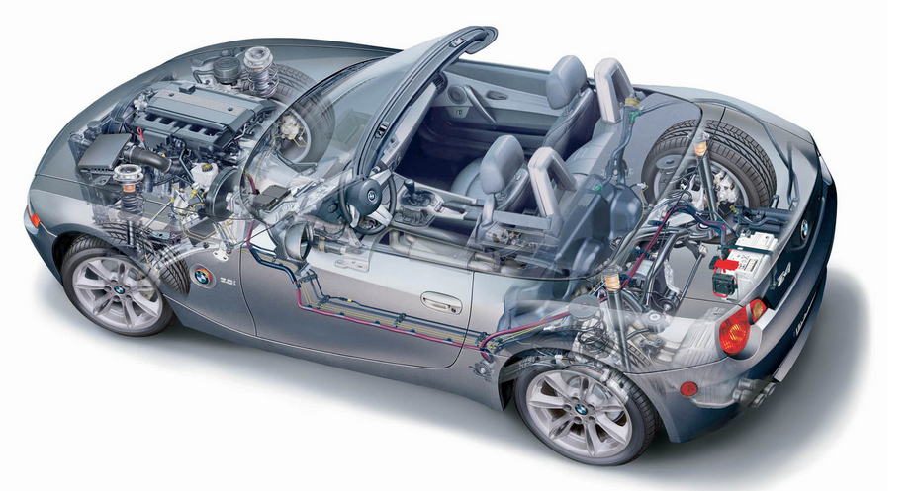
Encapsulation
Real world example

Slide 7
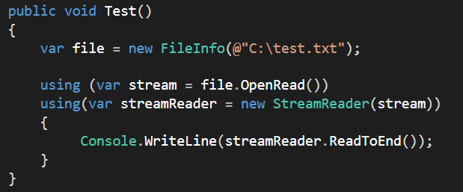
Encapsulation
Digital world example

Slide 8
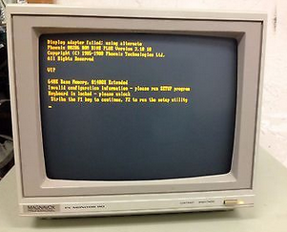
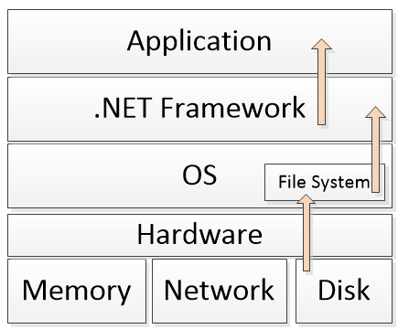
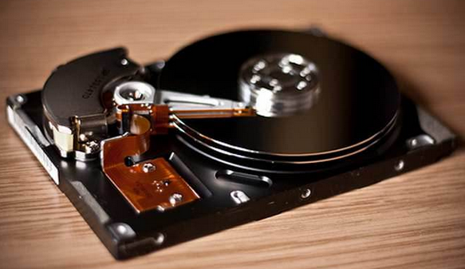
Encapsulation
Digital world example

Slide 9
Inheritance
Reuse common (state or behavior)
Extensible

Slide 10
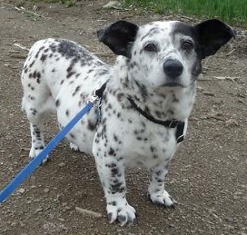
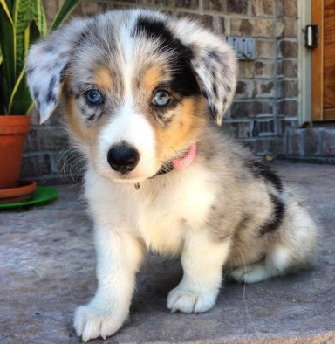
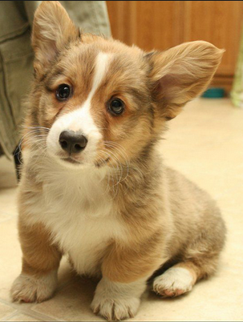
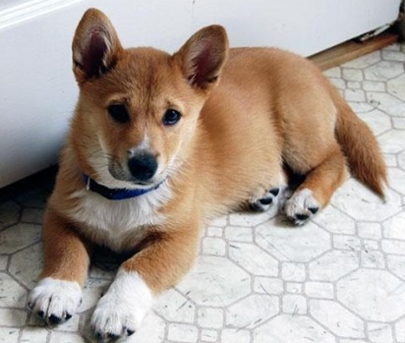


Inheritance
Real world example

Slide 11
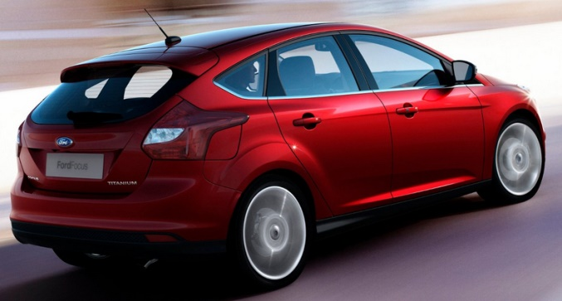


Inheritance
Real world example

Slide 12
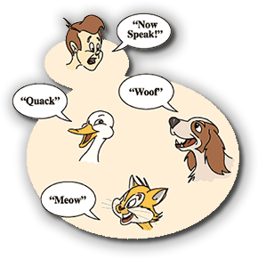
Polymorphism

Slide 13
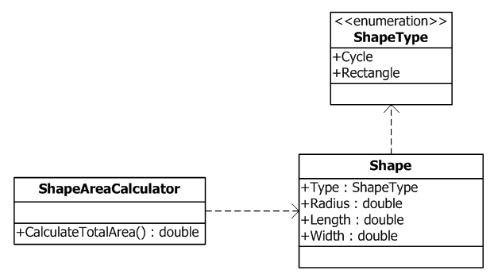
Polymorphism
Demo

Slide 14
OOP Principles (SOLID)
S
O
L
I
D

Slide 15
OOP Principles (SOLID)
SRP - Single Responsibility Principle
OCP - Open Close Principle
LSP - Liskov Substitution Principle
ISP - Interface Segregation Principle
DIP - Dependency Inversion Principle

Slide 16
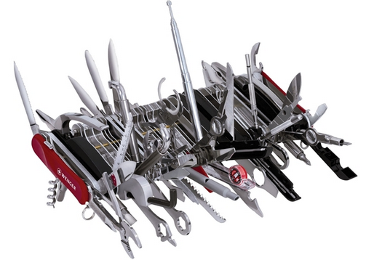
SRP - Single Responsibility Principle

Slide 17
SRP - Single Responsibility Principle
A class should have only one reason to change.
A class or method should do one thing.

Slide 18
OCP - Open Close Principle
Open to extension, closed to modification.

Slide 19
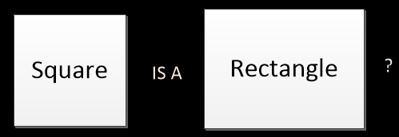
LSP - Liskov Substitution Principle
Sub classes should not break the behavior of the base class.
Does square is a special rectangle?
Demo

Slide 20
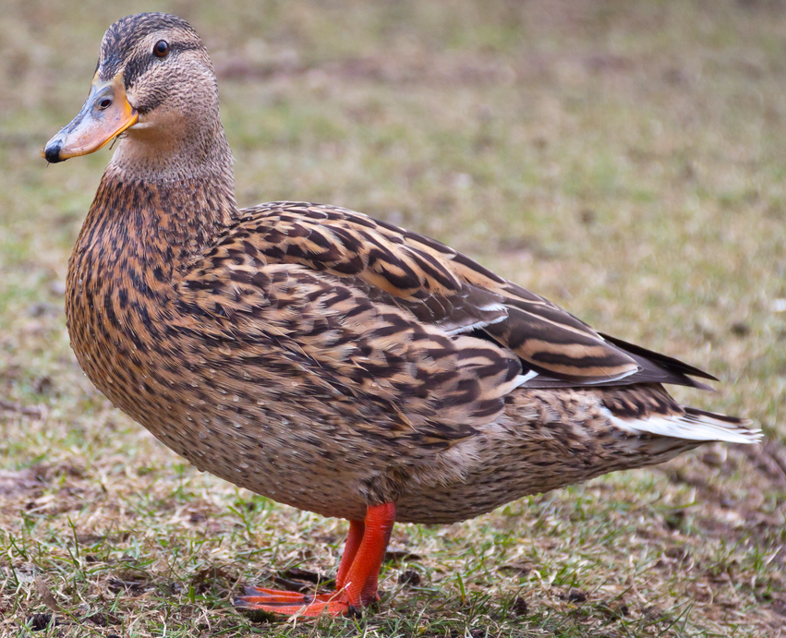

LSP - Liskov Substitution Principle

Slide 21
LSP - Liskov Substitution Principle
We cannot always one-to-one mapping real world objects to programing world objects.

Slide 22
ISP - Interface Segregation Principle
Separate behaviors into multiple small interfaces instead of a single fat interface.

Slide 23
ISP - Interface Segregation Principle

Slide 24
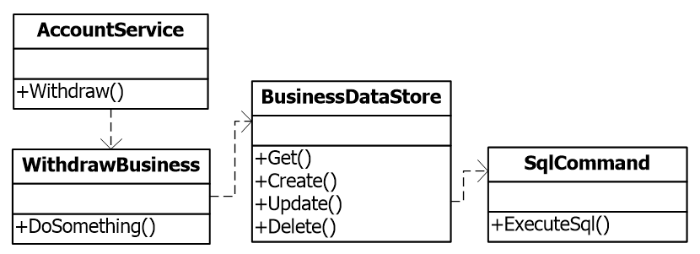
DIP - Dependency Inversion Principle

Slide 25
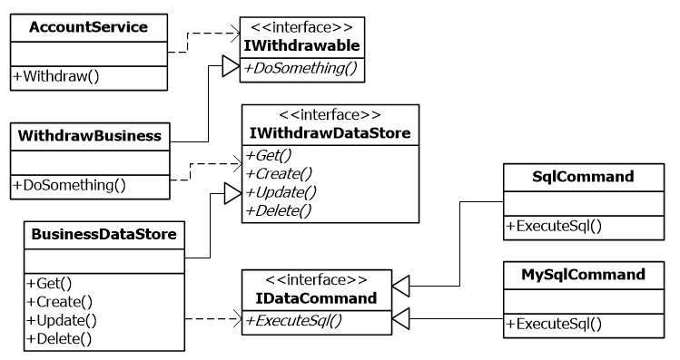
DIP - Dependency Inversion Principle

Slide 26
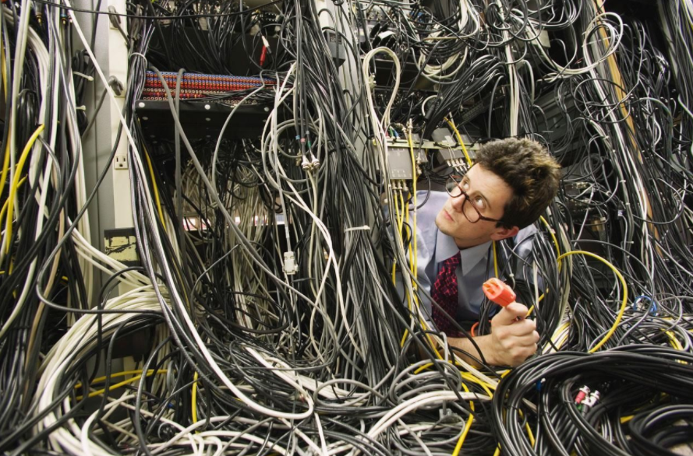
Summary

Slide 27
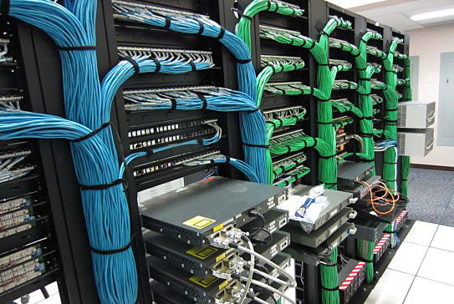
Summary
Try respect those principles, make your life easier.

